Slide 1
What are Intelligent Agents
Dr. Akram Hussain

Slide 2
Agent
An agent is anything that can be viewed as perceiving its environment through sensors
and
acting upon that environment through actuators.

Slide 3


Example
Agent
Environment
Percepts
Sensors
?
Acts
Actuators

Slide 4
Example
Robotic Agent?
Software Agent?

Slide 5
Example
Robotic Agent: the above example is the robotic agent.
Software Agent: it receives file contents, network
packets, and human input (keyboard/mouse) as sensory inputs and acts on the environment by writing files, sending network packets, and displaying information or generating sounds.

Slide 6
Percept Sequence
Agent
Environment
percept refers to the content an agent’s sensors are perceiving.
An agent’s percept sequence is the complete history of everything the agent has ever perceived.
Percepts
Sensors
?
Acts
Actuators

Slide 7
Agent Function
Agent
Environment
An agent’s behavior is
described by the agent function. Agent Function maps any given percept sequence to an action.
Percepts
Sensors
?
Acts
Actuators

Slide 8
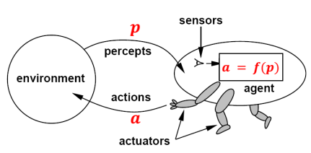

Agent Function
An agent’s behavior is
described by the agent function. Agent Function maps any given percept sequence to an action.
Agent function

Slide 9
Description methods of an agent
External Characterization
Internal Characterization

Slide 10
Tabulating an agent function!
External Characterization of an Agent:
Given an agent to experiment with, we can,
in principle, construct this table by trying out all possible percept sequences and recording
which actions the agent does in response.

Slide 11
Internal characterization of agent function!
Internal characterization describes how the agent is implemented internally.
Internally, the agent function for an artificial agent will be implemented by an agent program.
The agent function is an abstract mathematical description; the agent program is a concrete implementation, running within some physical system.
Agent = architecture (sensors, memory, actuators) + agent program (implementation of agent function)

Slide 12
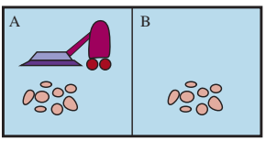
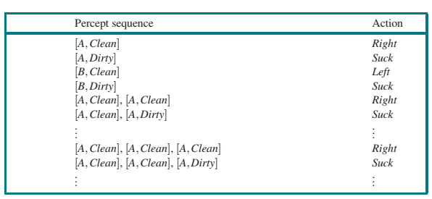
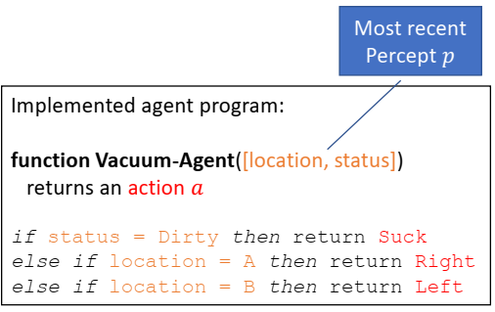
Example-Vacuum cleaner world
Percept: Location and Status, e.g. [A, Dirty]
Actions: Left, Right, Suck
External Characterization
Internal Characterization

Slide 13
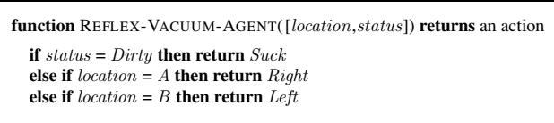
Internal characterization : agent program

Slide 14
Example
Self-driving car: percepts, actions, agent function, agent program?

Slide 15
Example
Self-driving car: percepts, actions, agent function, agent program?
Percepts: Videos and pictures from Cameras, Road conditions, GPS location, nearby cars, traffic signals
Actions: Accelerate, brake, steer left/right, signal turn,
Agent Function: Map all sensor inputs over time to the best driving action

Slide 16
Rational Agent
What is rational at any given time depends on four things:
The performance measure that defines the criterion of success.
The agent’s prior knowledge of the environment.
The available actions that the agent can perform.
The agent’s percept sequence to date.

Slide 17
Rational Agent
For each possible percept sequence, a rational agent should select an action that is expected to maximize its (expected) performance measure, given the evidence provided by the percept sequence and whatever built-in knowledge the agent has. (Example: Vacuum cleaner)

Slide 18
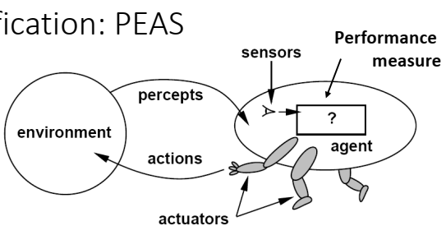
Task environment
Performance, environment, actuators, sensors (PEAS)
PEAS helps in designing and understanding
intelligent agents by clearly defining
what the agent should do, what it
can observe, and how it interacts
with the world.

Slide 19
Peas example
Self-Driving Car:
PEAS Components | Description
Performance
Environment
Actuators
Sensors

Slide 20
Peas example
Self-Driving Car:
PEAS Components | Description
Performance | Safety, time to destination, passenger comfort, fuel efficiency
Environment | Roads, traffic, pedestrians, weather
Actuators | Steering, accelerator, brake, horn, indicators
Sensors | Cameras, radar, GPS, speedometer, LiDAR, engine sensors

Slide 21
Peas example
Vacuum Cleaner:
PEAS Components | Description
Performance
Environment
Actuators
Sensors

Slide 22
Peas example
Vacuum Cleaner:
PEAS Components | Description
Performance | Cleanliness of the floor, energy usage, time taken
Environment | Rooms or grid with dirt and obstacles
Actuators | Motor to move and vacuum
Sensors | Dirt sensor, bump sensor, location sensor

Slide 23
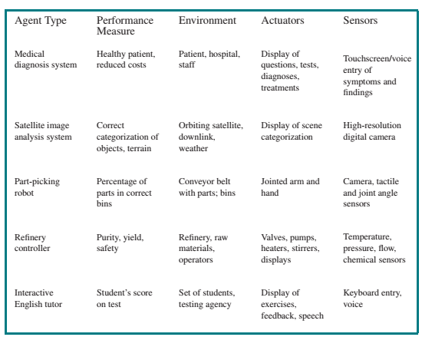
PEAS-more examples

Slide 24
Nature of Environment

Slide 25
Fully observable vs partial observable
Fully Observable Environment: If an agent’s sensors give it access to the complete state of the environment at each point in time.
The agent can “see” the whole environment.
Partial Observable Environment: The agent cannot observe the complete state of the environment because
noisy and inaccurate sensors
parts of the state are simply missing from the sensor data.

Slide 26

Fully Observable vs Partially Observable
Agent
Environment
Percepts
Sensors
?
Actuators
Acts

Slide 27
Example
Chess, Tic-Tac-Toe
Vacuum agent with a local dirt sensor ?
Self driving car?
If an agent has no sensors at al, then?

Slide 28
Deterministic vs nondeterministic
If the next state of the environment is completely determined by the current state and the action executed by the agent(s), then we say the
environment is deterministic; otherwise, it is nondeterministic or stochastic.
Deterministic Examples: Chess, Vacuum cleaner
Nondeterministic Examples: Self-driving cars, Weather prediction, Stock Market

Slide 29
Discrete vs continuous environments
Discrete: The environment provides a fixed number of distinct percepts, actions, and environment states. Or simply, countable states and countable actions.
Example: Chess, Sudoku Puzzle
Continuous: Percepts, actions, state variables or time are continuous leading to an infinite state, percept or action space. For instance, self-driving car, voice recognition.

Slide 30
Static vs dynamic
Static: The environment is not changing while agent is deliberating or taking decisions.
Dynamic: The environment is changing while
the agent is deliberating.
Example: Self-driving car, stock trading bots

Slide 31
Benign vs Adversarial
Agent
Environment
Percepts
Sensors
?
Acts
Actuators
Benign environment is not interested in making agent’s task worse.

Slide 32
Unmarked Quiz
Environment | Partially vs Fully Observable | Deterministic vs Nondeterministic | Continuous vs Discrete | Benign vs Adversarial
Checkers | Fully | Deterministic | Discrete | Adversarial
Image Analysis | Fully | Deterministic | Continuous | Benign
Self Driving Car | Partially | Nondeterministic | Continuous | Depends
Email Spam Filter | Fully | Deterministic | Discrete | Depends…
Youtube Recomm | Partially | Deterministic / Nondeterministic | Discrete | ????

Slide 33
AI agent (section 2.4)
The job of AI is to design an agent program that implements the agent function-the mapping from percepts to actions.
Architecture – computing devices with physical sensors and actuators. For example, PC, robot
Agent = architecture + program.

Slide 34
Basic kinds of agent programs
Simple reflex agents: select actions on the basis of the current percept, ignoring the rest of the percept history.
Model-based reflex agents: require a model (e.g., memory) of the environment.
Goal-based agents: need some sort of goal information that describes situations that are desirable in addition of current state.
Utility-based agents: happy and unhappy statuses based on goal-based agents are not sufficient. Performance score based.
Learning Agent: Learns from experience and improves performance over time.

Slide 35
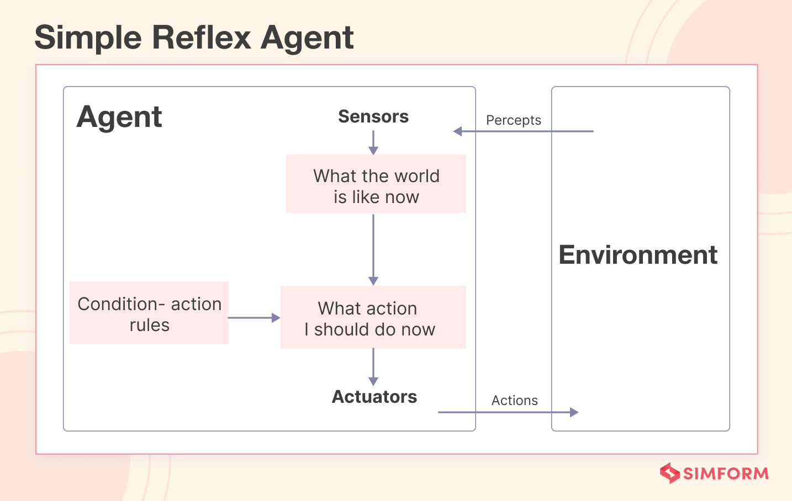
Simple reflex agent
Respond to current state
No memory
Succeed in fully observable environment
Predefined rules to state
Limited in intelligence

Slide 36
Model based reflex agents
Consider current percept and an internal model (memory) of the environment.
Can work in partially observable environment
Follows the condition-action rule while employing its internal state to assess the condition.
Example: Robot Vacuum
The robot may remember:
Which rooms it has visited.
Which areas have been cleaned.
Where obstacles are located.
Its current position.

Slide 37
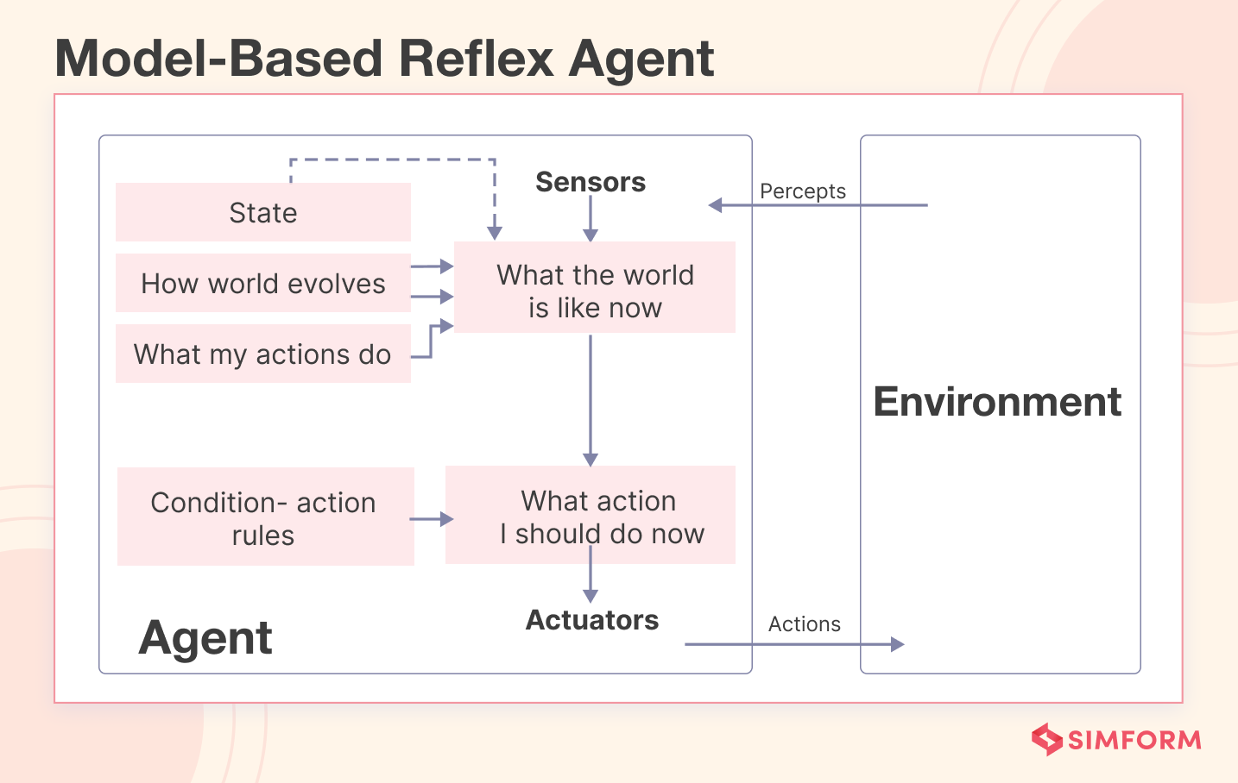
Model based reflex agents

Slide 38
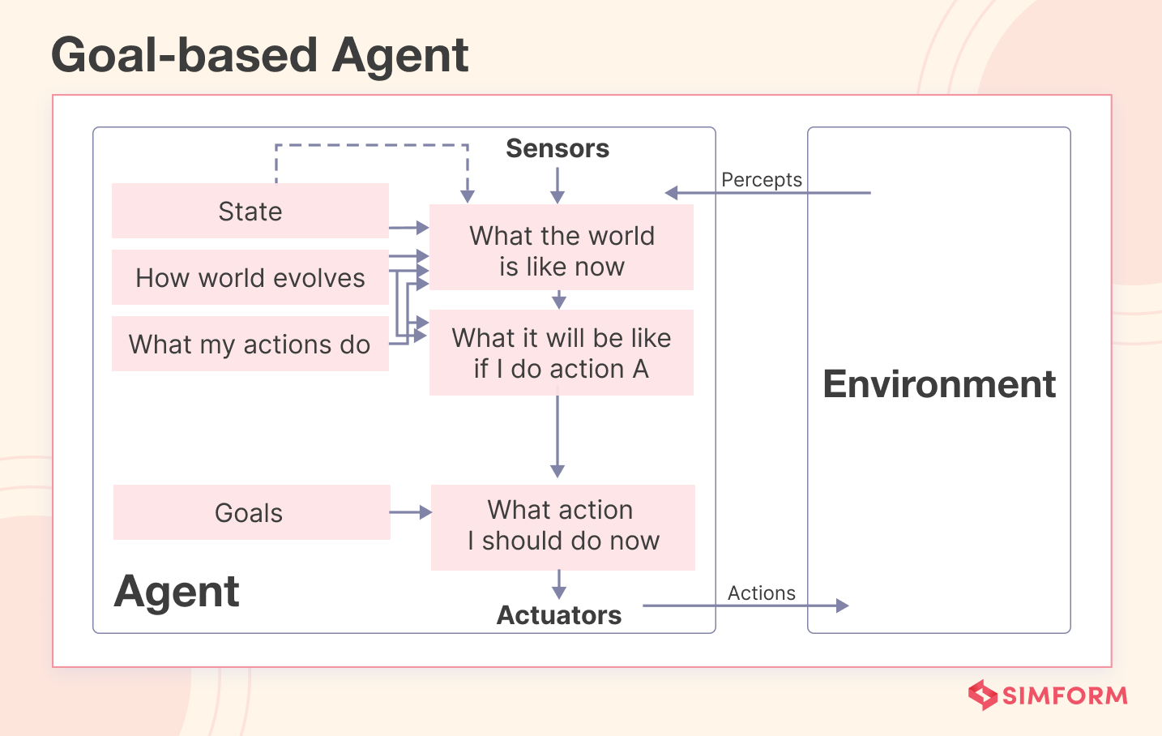
Goal based agents
Similar to Model-Based agents and also uses goal information
Uses search algorithms for efficiently achieving goals

Slide 39
Utility-based agents
Act based not only goals but also the best way to achieve the goal.
The utility function maps each state to a real number to check how efficiently each action achieves the goals

Slide 40
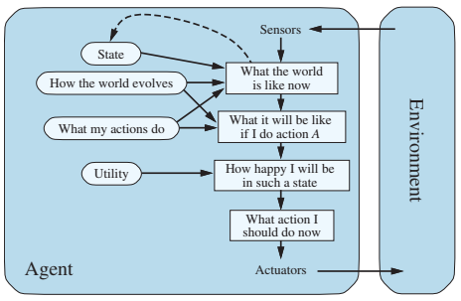
Utility-based agents

Slide 41
Learning agent
A Learning Agent is an agent that can improve its performance through experience.
Instead of relying entirely on predefined rules, it learns from:
Experience
Data
Feedback
Rewards
Mistakes

Slide 42
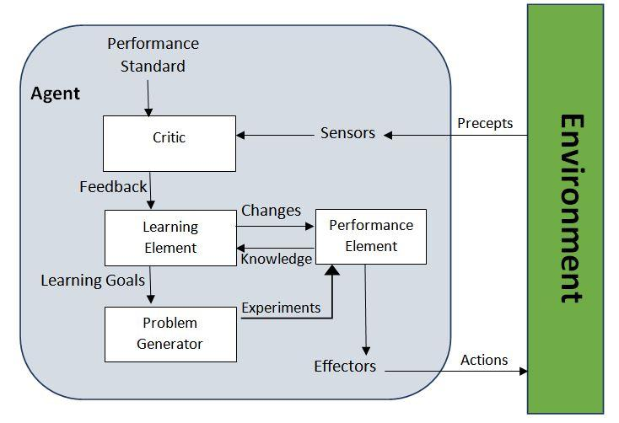
Learning agent

